Slide 1

Real Time Target Detection And Liquidation with Drones
Capstone Project Phase 2 21-2-D-17
Alon Barenboim Alexey Smirnov
Supervisor: Dr. Elena Ravve

Slide 2
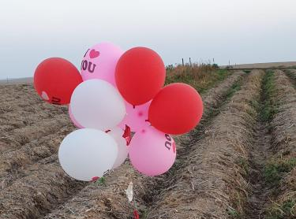
Purpose of the project
Incendiary balloons became a strategic weapon for Hamas in Gaza strip
No efficient and reliable solution has been found since 2018
Our project purpose is to identify and liquidate the balloons before they arrive to civilian areas
Notes:
Since 2018, the southern district of Israel is under attack by Incendiary aerostats, which is a simple, primitive weapon which the Israeli army cannot handle using the Advanced (Maybe even too advanced) Iron Dome system. The usage in aerostats as a weapon started decades ago. The first known attempt to make a bomb balloon was in the end of 18’th century. Until now, no permanent, efficient and scalable solution was found. This can be a strategic threat for Israel, as the aerostats can carry wide variety of weapons, including bombs, Molotov bottles and so on, and can unexpectedy go very far with the wind force. An example for this threat has been recorded in Oct 18 as a bomb balloon was found in Rishon Letzion, 55km for the Gaza Strip.

Slide 3
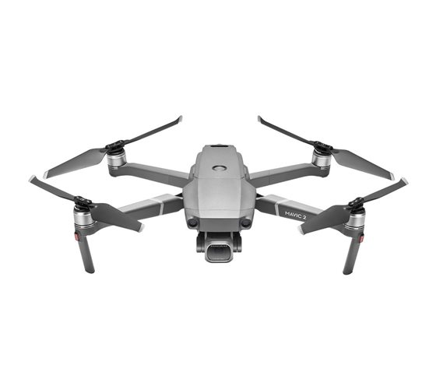


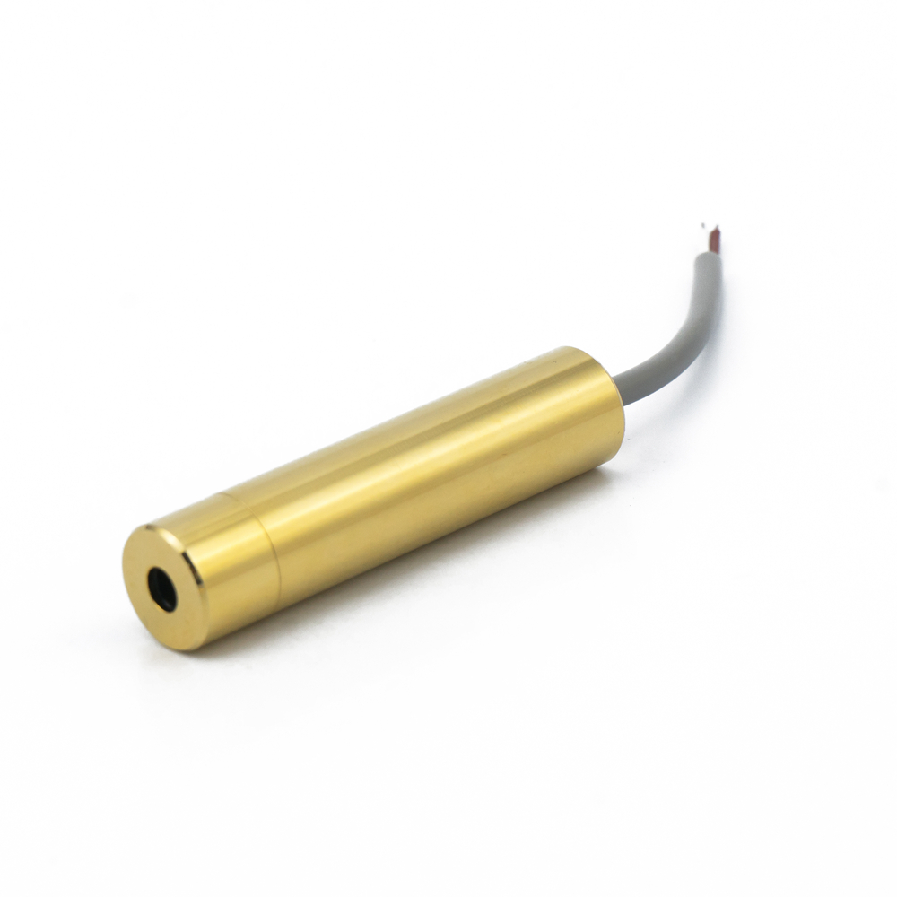

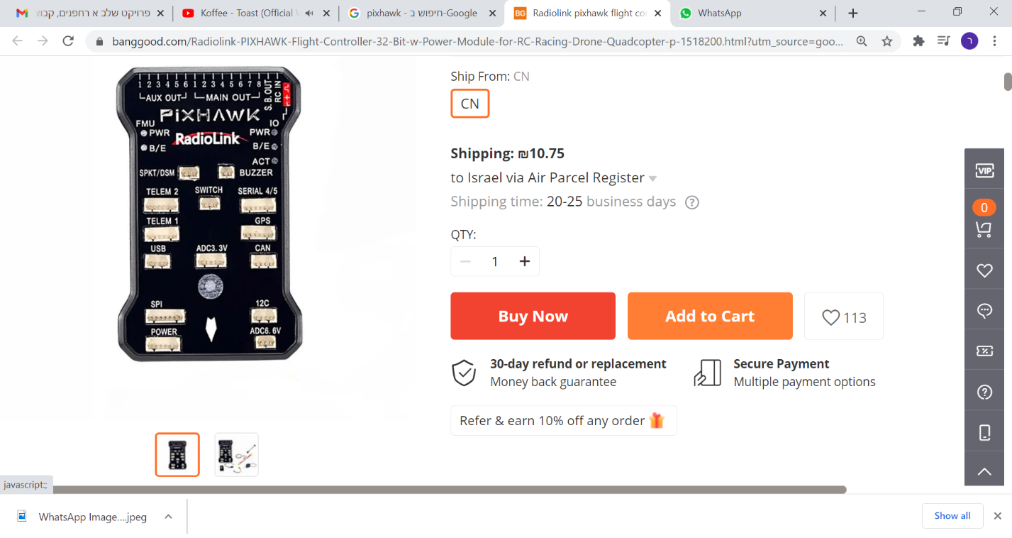
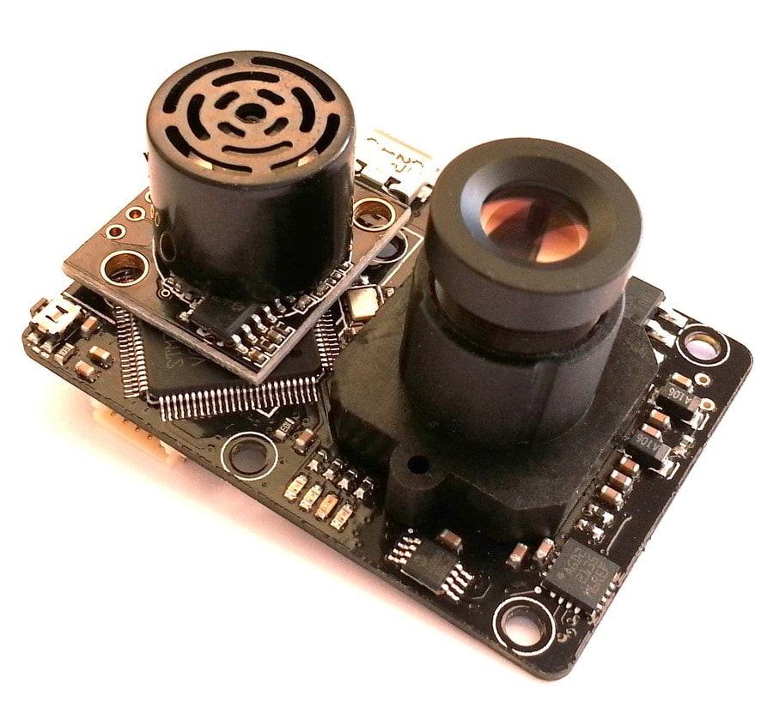
Our Solution
Algorithm
Target
Drone and Camera
Radio
Laser Module
PIXHAWK
Optical Flow Sensor
Ground PC
Notes:
Our proposed solution is a Drone with a built in High Res Camera, which carries A laser module installed on a mechanism which controlled by A Micro Controller. The micro controller receives and sends information to a ground control PC using Radio connection. The ground station program Is capable of notify about detected threats in the drones sight, and show a bounding box of the threat in real time video stream. The controller can decide whether he want’s to destroy it or not. If he does, the laser will track the object automatically using the optical flow and machine learning algorithms, and then liquidate it.

Slide 4
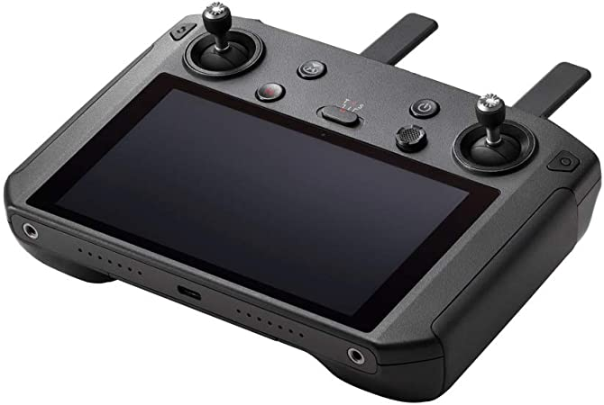
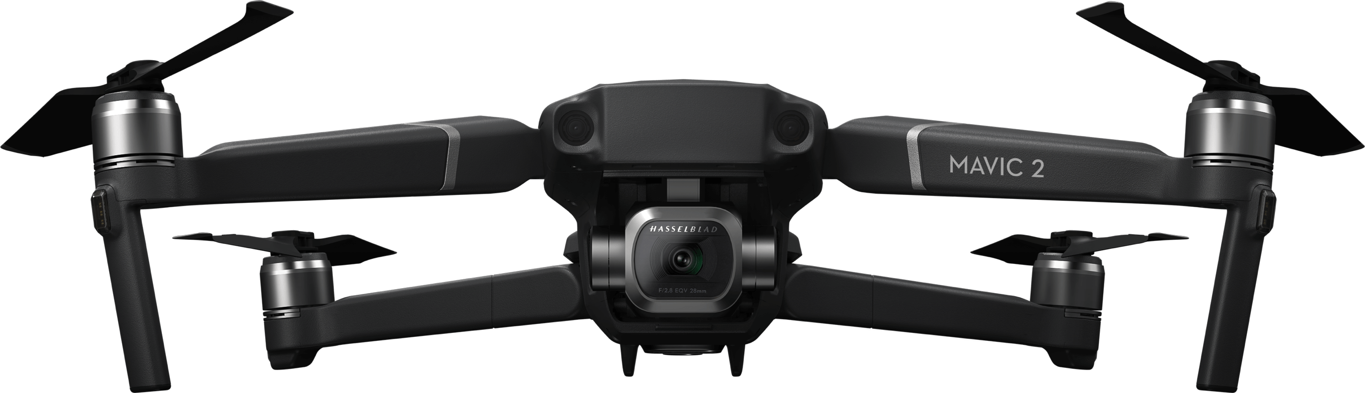
Project’s Equipment
PIXHAWK
Hardware and software system for micro air vehicles.
Based on Arduino, Programmable easily
It controls both the Radio Antenna and Laser Holding Mechanism
DJI Mavic Pro 2 Drone
Unfolded: 322×242×84mm
Max Speed: 72 kph
Max distance: 8Km
Flight Time: 31min
DJI Smart Controller
5.5-Inch built-in display
HDMI port
Allow us built-in camera usage and ground control connection
Notes:
Now I’m going to tell more about the equipment we are going to use to achieve our goals in this project. So the main component will be, of course, the drone. We are using the DJI Mavic Pro 2 drone, which is a professional drone for high distance real time filming.
The drone can fly as far as 8KM from the remote control, in a maximum speed of 72KPH, and will do it for as long as 31Min.
The next thing we are going to use is the DJI Smart Controller, which adds the ability to transmit the video stream to the ground control pc through an HDMI cable
It also includes a 5.5inch built in screen for easier control, and allow us the usage of the built in drone’s camera. Another major component will be the P4Xflow.
The P4XFLOW is an open source optical flow module that has a high resolution camera pointing downwards,
which is able to determine the ground velocity of the drone according to texture and other visible features.

Slide 5
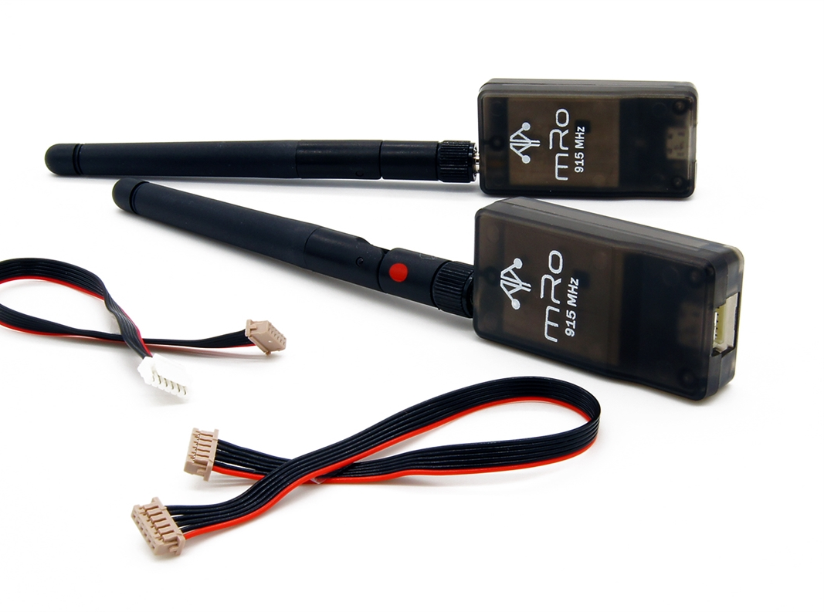
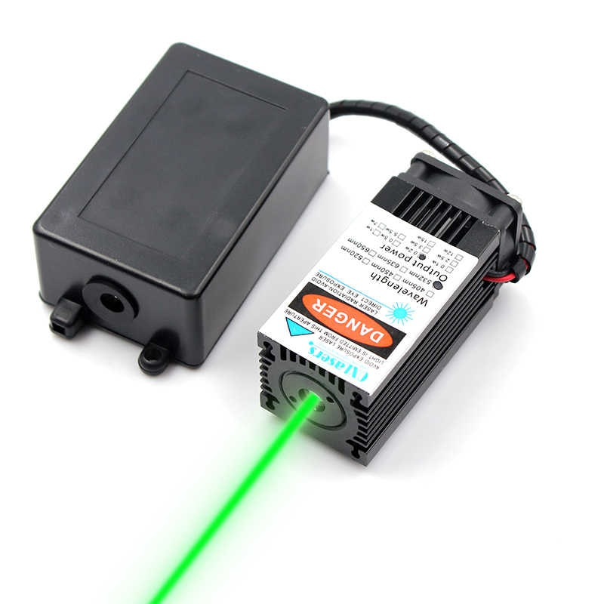
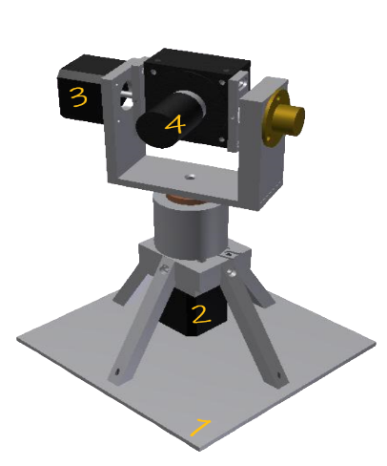
Project’s Equipment (Continue)
SiK Telemetry Radio
Small, Light, Inexpensive Radio Module
Allows ranges of several kilometers
Specially designed to be integrated with the AutoPilot software
Laser Diode Module
Laser can be focused to a tight spot, enabling applications such as laser cutting
A high-power laser module allows balloon explosion
200mW Green Laser Module
Laser Holding Mechanism
Two rotary engines
One motor is responsible for laser movement around a horizontal axis
The other one is responsible for the movement around a vertical axis
A 3D Printed holding arm
Notes:
We also have the SiK telemetry radio.
This component is a small, light and inexpensive radio module, which allows us to communicate with the drone for a distance which is as far as the drones remote – several kilometers.
The module is also specifically designed to be integrated with the AutoPilot software I already talked about.
Next we have the second most important component which is the laser module itself.
So a laser is an acrynom for “Light Amplification by stimulated emission of radiation”.
What’s so special about lasers is the fact that a spatial coherence allows the laser to be focused to a tight spot,
which enables application such as laser cutting, which is the purpose of it in our project.
We’ll use a 200mw green laser module in our project which should be sufficient for balloons explosion.
Last component in our project will be the Laser Holding Mechanism.
The original mechanism was built by previous team and consist of 2 rotary motors,
Which connected to one another, and which hold a 3D printed holding arm.
One of the motors controls the vertical movement of the laser holding arm,
and the second controls the horizontal movement.
The mechanism design we got from the previous team had to be changed
Due to a fault in it’s design, but we already took care of that problem and now it’s working as intended.

Slide 6
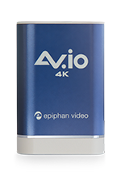
Project’s Equipment (Continue)
AV.IO 4K Capture Card
HDMI Video Capture Card
UHD 4K at 30 fps and HD 1080p at 60fps
USB 3.0 SuperSpeed
Notes:
We also have the SiK telemetry radio.
This component is a small, light and inexpensive radio module, which allows us to communicate with the drone for a distance which is as far as the drones remote – several kilometers.
The module is also specifically designed to be integrated with the AutoPilot software I already talked about.
Next we have the second most important component which is the laser module itself.
So a laser is an acrynom for “Light Amplification by stimulated emission of radiation”.
What’s so special about lasers is the fact that a spatial coherence allows the laser to be focused to a tight spot,
which enables application such as laser cutting, which is the purpose of it in our project.
We’ll use a 200mw green laser module in our project which should be sufficient for balloons explosion.
Last component in our project will be the Laser Holding Mechanism.
The original mechanism was built by previous team and consist of 2 rotary motors,
Which connected to one another, and which hold a 3D printed holding arm.
One of the motors controls the vertical movement of the laser holding arm,
and the second controls the horizontal movement.
The mechanism design we got from the previous team had to be changed
Due to a fault in it’s design, but we already took care of that problem and now it’s working as intended.

Slide 7
What was done so far ?
This is a continuing project, which started 3 years ago
Fatina Sirhan, Shifaa Salih: Aerostats Detection Algorithm
Razie Fadool, Mohammed Aboraya: Camouflaged Detection Algorithm
Soaad Amer, Omar Hallomi: Laser Mechanism

Slide 8

Aerostats Detection Algorithm
Previous algorithm maximal inference speed was 15 FPS
In order to detect and liquidate targets in real time – minimum of 24 FPS is required
We decided to implement another detection architecture – YOLO
Notes:
The challenges we expect to face during the project are: radio connection – the connection method between ground station pc and the drone wasn’t established yet, and real life performance and range is yet to be known. That’s a challenge we know that we’ll face.
Another issue that we have to solve is where will the real time image processing will be done, in ground PC or drone.
The connection has to be secured as hackers could try and take control over the drone, and use it for illegal purposes. As the laser is a lethal device, it has to stay in the qualified hands.
Components installation –
The laser mechanism, the PIXHAWK controller, the P4XFLOW sensor, light battery and radio module, are all pretty large components which need to be assembled on the Drone which is a very compact device that’s not meant to carry third party devices.
Realtime Detection – Object detection in a static image is pretty easily achievable, but object detection in real time video stream using a compact device that runs on battery is a totally different story. Real time detection was yet to be made by previous teams so it’s up to us.
Target Coordinates –
The target coordination relative to the drone has to be calculated in a dynamic way in real time, as the position of the drone is continuously changes, and the target position also.
And that’s cause us another problem –
In order to successfully liquidate an object using laser, we have to make sure that a very small part of the target is always pointed.
Small movements of the laser beam are not acceptable.
We are going to tackle this issue, hopefully, with the Pixhawk and Optical Flow sensor, and a specific algorithm.

Slide 9
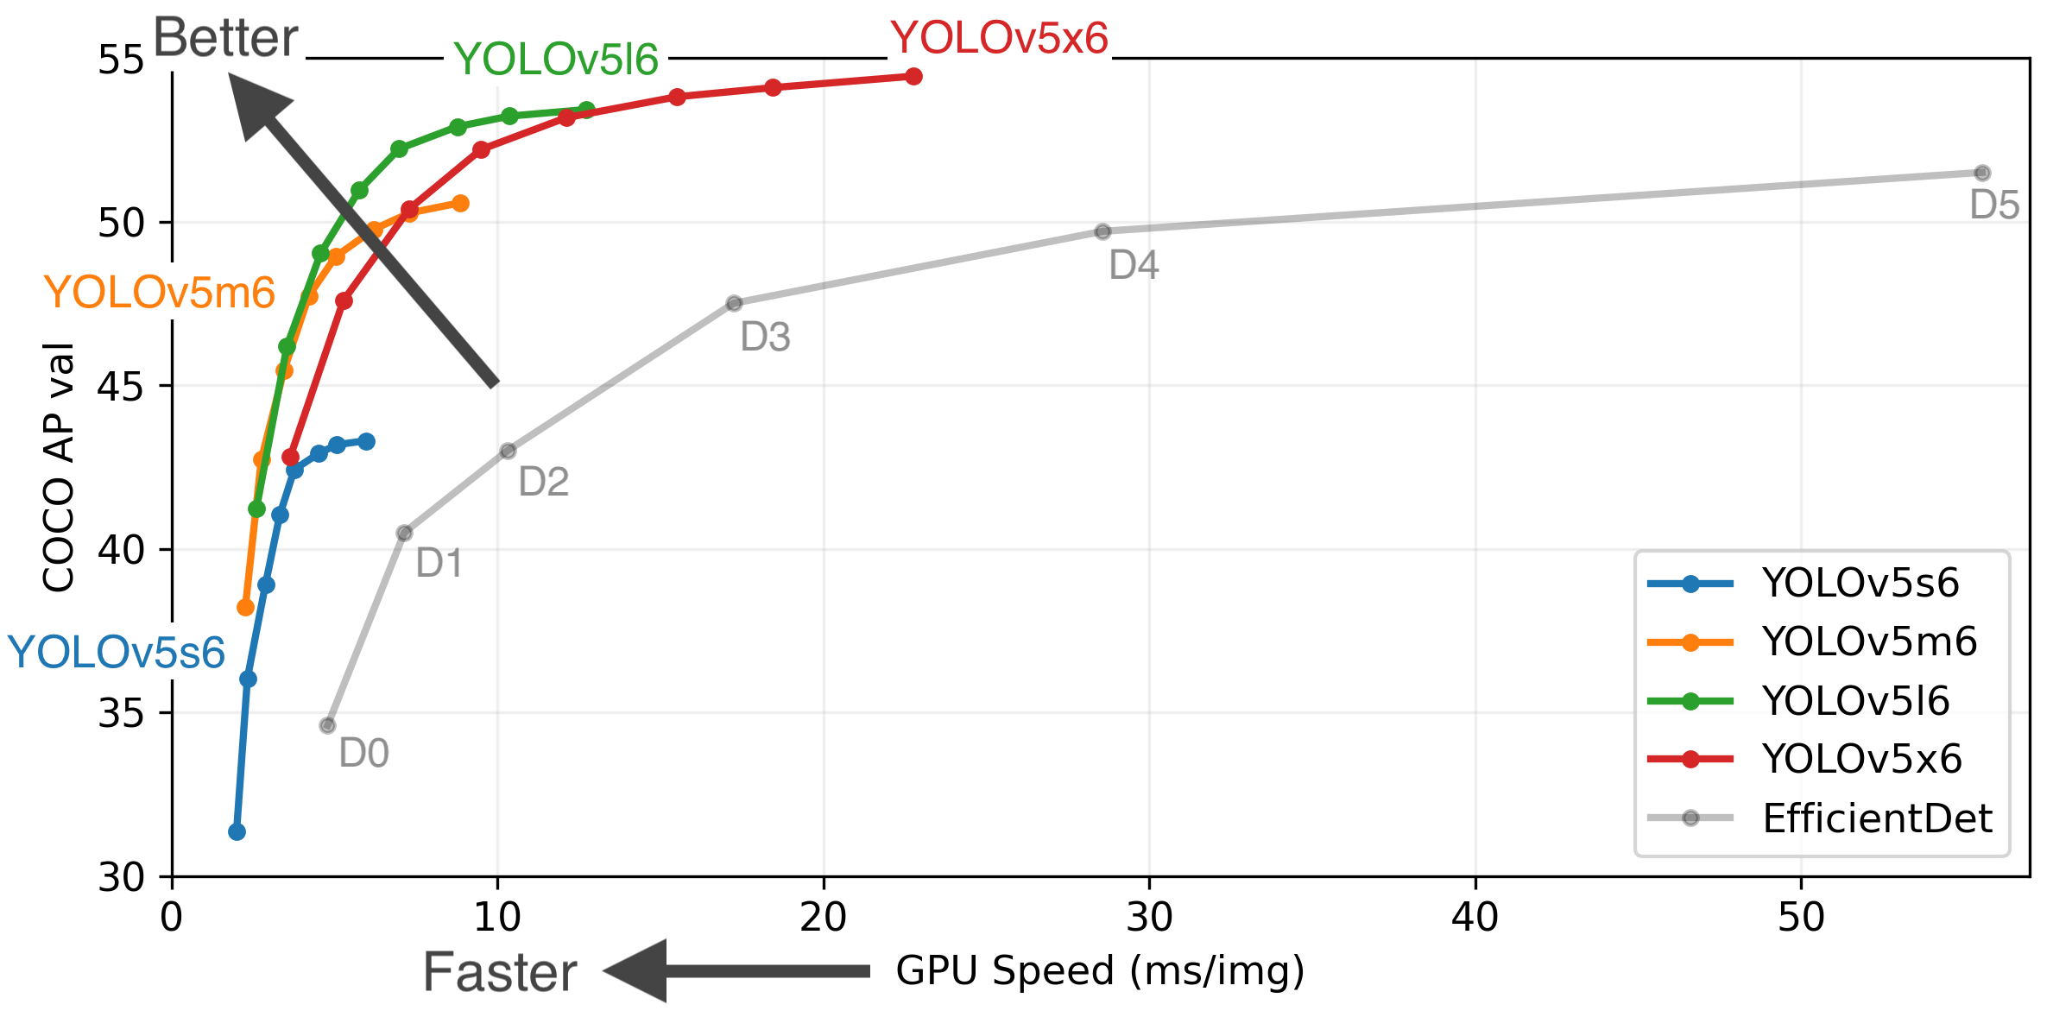
Aerostats Detection Algorithm
Our aerostats detection algorithm is based on YOLOv5
YOLO is an acronym for `You Only Look Once`. It is a family of object detection architectures and models that divides images into a grid system.
Each cell in the grid is responsible for detecting objects within itself.
Notes:
The challenges we expect to face during the project are: radio connection – the connection method between ground station pc and the drone wasn’t established yet, and real life performance and range is yet to be known. That’s a challenge we know that we’ll face.
Another issue that we have to solve is where will the real time image processing will be done, in ground PC or drone.
The connection has to be secured as hackers could try and take control over the drone, and use it for illegal purposes. As the laser is a lethal device, it has to stay in the qualified hands.
Components installation –
The laser mechanism, the PIXHAWK controller, the P4XFLOW sensor, light battery and radio module, are all pretty large components which need to be assembled on the Drone which is a very compact device that’s not meant to carry third party devices.
Realtime Detection – Object detection in a static image is pretty easily achievable, but object detection in real time video stream using a compact device that runs on battery is a totally different story. Real time detection was yet to be made by previous teams so it’s up to us.
Target Coordinates –
The target coordination relative to the drone has to be calculated in a dynamic way in real time, as the position of the drone is continuously changes, and the target position also.
And that’s cause us another problem –
In order to successfully liquidate an object using laser, we have to make sure that a very small part of the target is always pointed.
Small movements of the laser beam are not acceptable.
We are going to tackle this issue, hopefully, with the Pixhawk and Optical Flow sensor, and a specific algorithm.

Slide 10
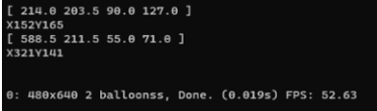
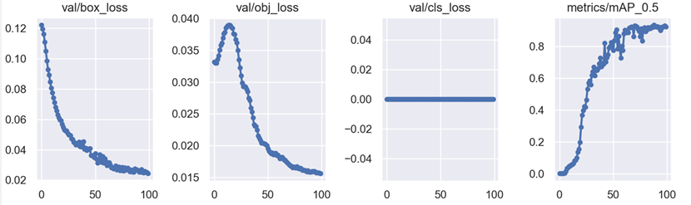
Aerostats Detection Algorithm Performance
One frame processing of our Balloon detection algorithm
takes 0.025ms = 40 FPS on average
(Nvidia RTX3060+AMD Ryzen5 3600)
The drone is capable of streaming at 24/25/30/48/50/60 FPS at 2K resolution
So our algorithm is capable of real time detection when the stream rate set to be lower than 30 FPS.
Mean Average Precision
Object Loss
Class Loss
Box Loss
Training Epoch
Training Epoch
Training Epoch
Training Epoch
Notes:
The challenges we expect to face during the project are: radio connection – the connection method between ground station pc and the drone wasn’t established yet, and real life performance and range is yet to be known. That’s a challenge we know that we’ll face.
Another issue that we have to solve is where will the real time image processing will be done, in ground PC or drone.
The connection has to be secured as hackers could try and take control over the drone, and use it for illegal purposes. As the laser is a lethal device, it has to stay in the qualified hands.
Components installation –
The laser mechanism, the PIXHAWK controller, the P4XFLOW sensor, light battery and radio module, are all pretty large components which need to be assembled on the Drone which is a very compact device that’s not meant to carry third party devices.
Realtime Detection – Object detection in a static image is pretty easily achievable, but object detection in real time video stream using a compact device that runs on battery is a totally different story. Real time detection was yet to be made by previous teams so it’s up to us.
Target Coordinates –
The target coordination relative to the drone has to be calculated in a dynamic way in real time, as the position of the drone is continuously changes, and the target position also.
And that’s cause us another problem –
In order to successfully liquidate an object using laser, we have to make sure that a very small part of the target is always pointed.
Small movements of the laser beam are not acceptable.
We are going to tackle this issue, hopefully, with the Pixhawk and Optical Flow sensor, and a specific algorithm.

Slide 11
Camouflage Detection Algorithm
The algorithm made by previous group of students, and is based on 13 Haralick features and SVM (Support Vector Machine)
It detects camouflage objects successfully in 24FPS.
We tried to connect it to OpenCV Webcam Video Capture Library for real-time stream inference, but with no success.
Notes:
The challenges we expect to face during the project are: radio connection – the connection method between ground station pc and the drone wasn’t established yet, and real life performance and range is yet to be known. That’s a challenge we know that we’ll face.
Another issue that we have to solve is where will the real time image processing will be done, in ground PC or drone.
The connection has to be secured as hackers could try and take control over the drone, and use it for illegal purposes. As the laser is a lethal device, it has to stay in the qualified hands.
Components installation –
The laser mechanism, the PIXHAWK controller, the P4XFLOW sensor, light battery and radio module, are all pretty large components which need to be assembled on the Drone which is a very compact device that’s not meant to carry third party devices.
Realtime Detection – Object detection in a static image is pretty easily achievable, but object detection in real time video stream using a compact device that runs on battery is a totally different story. Real time detection was yet to be made by previous teams so it’s up to us.
Target Coordinates –
The target coordination relative to the drone has to be calculated in a dynamic way in real time, as the position of the drone is continuously changes, and the target position also.
And that’s cause us another problem –
In order to successfully liquidate an object using laser, we have to make sure that a very small part of the target is always pointed.
Small movements of the laser beam are not acceptable.
We are going to tackle this issue, hopefully, with the Pixhawk and Optical Flow sensor, and a specific algorithm.

Slide 12
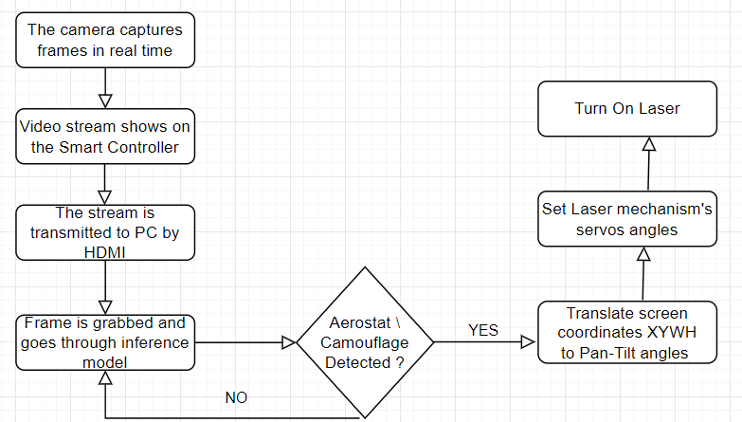
System’s Flow Chart

Slide 13
Testing Use Cases
Test ID | Description | Expected Results | Results
Define the maximum distance that the laser is able to destroy objects. | According to the laser specification the beam can travel around 30-40 miles. We need to make sure that object liquidation is possible in that range. | At least 30 miles range for object destruction. | The laser destroyed only a black balloon at 3-5 meters. With a brighter colored target or a further from the target the laser did nothing.
Multiple Targets Detected Simultaneously | The system has to handle many targets in one time without loosing effectiveness | Multiple objects detected will not interfere with liquidation process of a specific target | The system aims for the first one in the queue.
High Speed Object Tracking | The drone must keep track on an object in a high speed flight, as aerostats are not static. | As long as the aerostat appears inside the picture frame, it could be detected no matter what speed it flies. | Could not be tested as there is no Radio module , and the system could not work wirelessly for the test
High Wind-Speed Effectiveness | The drone must operate in high wind speeds environment | P4XFlow as well as DJI's drone stabilization system should be sufficient for wind handling | Could not be tested as there is no Radio module , and the system could not work wirelessly for the test

Slide 14
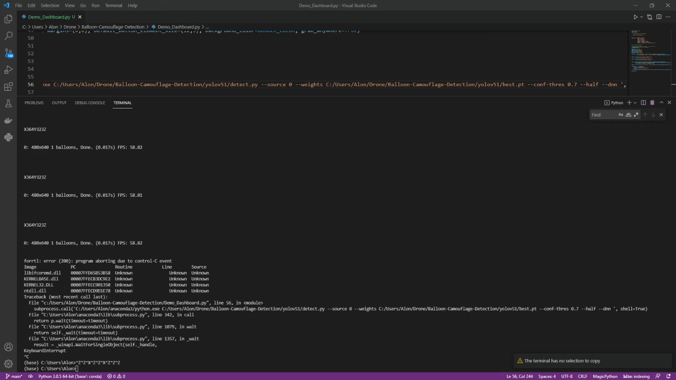
GUI Demostration
Notes:
The challenges we expect to face during the project are: radio connection – the connection method between ground station pc and the drone wasn’t established yet, and real life performance and range is yet to be known. That’s a challenge we know that we’ll face.
Another issue that we have to solve is where will the real time image processing will be done, in ground PC or drone.
The connection has to be secured as hackers could try and take control over the drone, and use it for illegal purposes. As the laser is a lethal device, it has to stay in the qualified hands.
Components installation –
The laser mechanism, the PIXHAWK controller, the P4XFLOW sensor, light battery and radio module, are all pretty large components which need to be assembled on the Drone which is a very compact device that’s not meant to carry third party devices.
Realtime Detection – Object detection in a static image is pretty easily achievable, but object detection in real time video stream using a compact device that runs on battery is a totally different story. Real time detection was yet to be made by previous teams so it’s up to us.
Target Coordinates –
The target coordination relative to the drone has to be calculated in a dynamic way in real time, as the position of the drone is continuously changes, and the target position also.
And that’s cause us another problem –
In order to successfully liquidate an object using laser, we have to make sure that a very small part of the target is always pointed.
Small movements of the laser beam are not acceptable.
We are going to tackle this issue, hopefully, with the Pixhawk and Optical Flow sensor, and a specific algorithm.

Slide 15
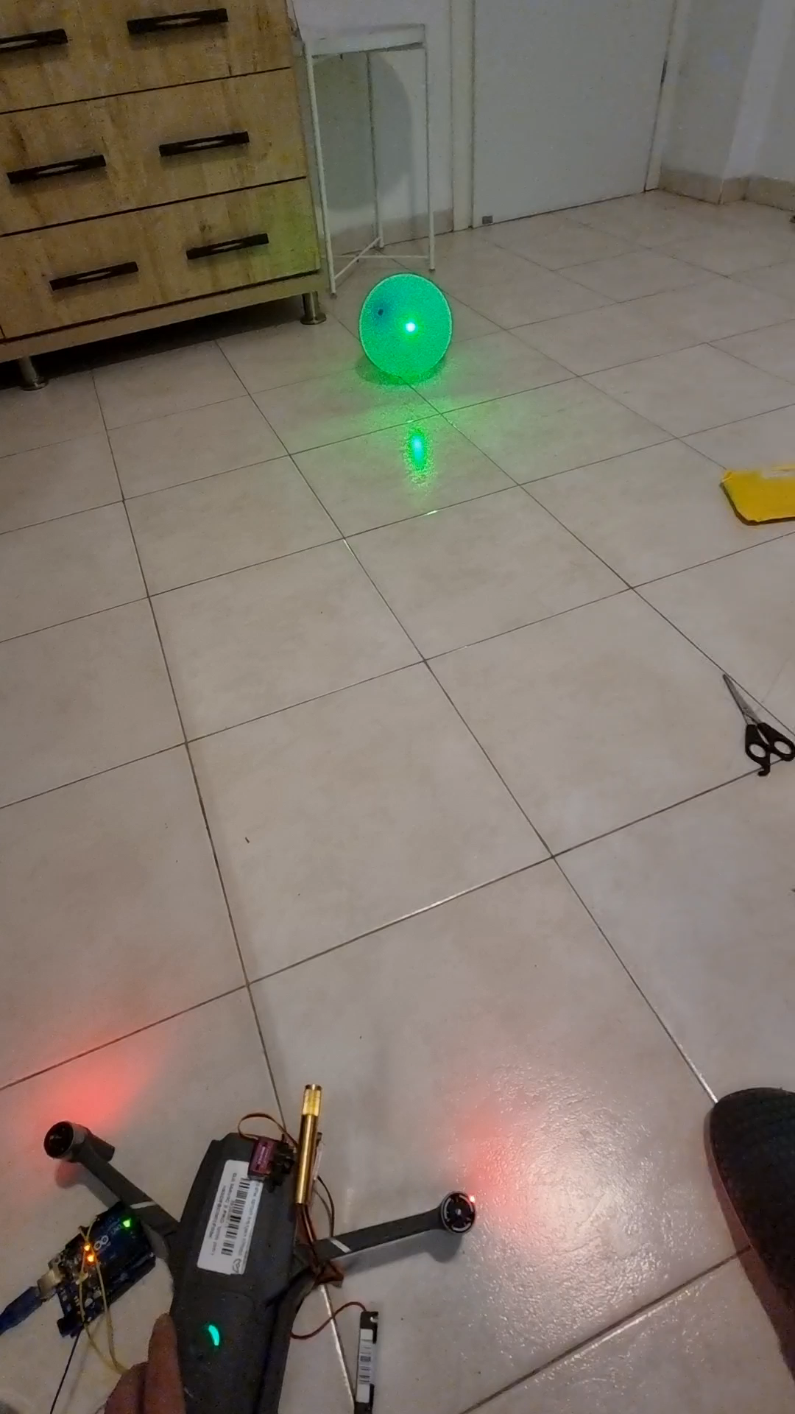
Liquidation Demonstration
Notes:
The challenges we expect to face during the project are: radio connection – the connection method between ground station pc and the drone wasn’t established yet, and real life performance and range is yet to be known. That’s a challenge we know that we’ll face.
Another issue that we have to solve is where will the real time image processing will be done, in ground PC or drone.
The connection has to be secured as hackers could try and take control over the drone, and use it for illegal purposes. As the laser is a lethal device, it has to stay in the qualified hands.
Components installation –
The laser mechanism, the PIXHAWK controller, the P4XFLOW sensor, light battery and radio module, are all pretty large components which need to be assembled on the Drone which is a very compact device that’s not meant to carry third party devices.
Realtime Detection – Object detection in a static image is pretty easily achievable, but object detection in real time video stream using a compact device that runs on battery is a totally different story. Real time detection was yet to be made by previous teams so it’s up to us.
Target Coordinates –
The target coordination relative to the drone has to be calculated in a dynamic way in real time, as the position of the drone is continuously changes, and the target position also.
And that’s cause us another problem –
In order to successfully liquidate an object using laser, we have to make sure that a very small part of the target is always pointed.
Small movements of the laser beam are not acceptable.
We are going to tackle this issue, hopefully, with the Pixhawk and Optical Flow sensor, and a specific algorithm.

Slide 16
What did go well ?
We implemented a new algorithm for balloons detection
Our balloon algorithm average inference speed per frame is 0.025ms = 40 FPS on average.
We connected the laser mechanism to the algorithm, and it successfully point the laser beam to the target
We learned how to use and implement OpenCV library and modules in our algorithm
Notes:
The challenges we expect to face during the project are: radio connection – the connection method between ground station pc and the drone wasn’t established yet, and real life performance and range is yet to be known. That’s a challenge we know that we’ll face.
Another issue that we have to solve is where will the real time image processing will be done, in ground PC or drone.
The connection has to be secured as hackers could try and take control over the drone, and use it for illegal purposes. As the laser is a lethal device, it has to stay in the qualified hands.
Components installation –
The laser mechanism, the PIXHAWK controller, the P4XFLOW sensor, light battery and radio module, are all pretty large components which need to be assembled on the Drone which is a very compact device that’s not meant to carry third party devices.
Realtime Detection – Object detection in a static image is pretty easily achievable, but object detection in real time video stream using a compact device that runs on battery is a totally different story. Real time detection was yet to be made by previous teams so it’s up to us.
Target Coordinates –
The target coordination relative to the drone has to be calculated in a dynamic way in real time, as the position of the drone is continuously changes, and the target position also.
And that’s cause us another problem –
In order to successfully liquidate an object using laser, we have to make sure that a very small part of the target is always pointed.
Small movements of the laser beam are not acceptable.
We are going to tackle this issue, hopefully, with the Pixhawk and Optical Flow sensor, and a specific algorithm.

Slide 17
What didn’t go well ?
We didn’t receive the SiK Radio Antenna module, so we couldn’t test the laser mechanism operation wirelessly.
A battery for the Pixhawk, Laser Module and Mechanism is missing.
The previous aerostat detection algorithm didn’t work in real time, so we had to implement and learn another one.
Our attempts to make the camouflage detection algorithm work in real time from camera stream was unsuccessful.
Notes:
The challenges we expect to face during the project are: radio connection – the connection method between ground station pc and the drone wasn’t established yet, and real life performance and range is yet to be known. That’s a challenge we know that we’ll face.
Another issue that we have to solve is where will the real time image processing will be done, in ground PC or drone.
The connection has to be secured as hackers could try and take control over the drone, and use it for illegal purposes. As the laser is a lethal device, it has to stay in the qualified hands.
Components installation –
The laser mechanism, the PIXHAWK controller, the P4XFLOW sensor, light battery and radio module, are all pretty large components which need to be assembled on the Drone which is a very compact device that’s not meant to carry third party devices.
Realtime Detection – Object detection in a static image is pretty easily achievable, but object detection in real time video stream using a compact device that runs on battery is a totally different story. Real time detection was yet to be made by previous teams so it’s up to us.
Target Coordinates –
The target coordination relative to the drone has to be calculated in a dynamic way in real time, as the position of the drone is continuously changes, and the target position also.
And that’s cause us another problem –
In order to successfully liquidate an object using laser, we have to make sure that a very small part of the target is always pointed.
Small movements of the laser beam are not acceptable.
We are going to tackle this issue, hopefully, with the Pixhawk and Optical Flow sensor, and a specific algorithm.

Slide 18
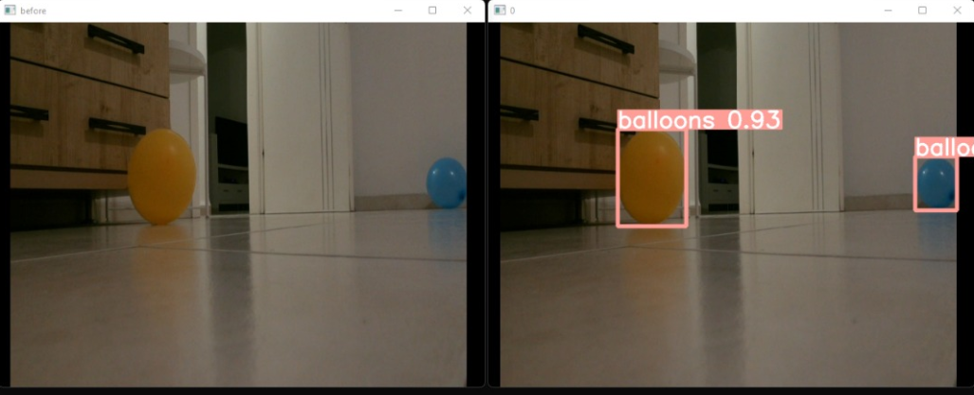
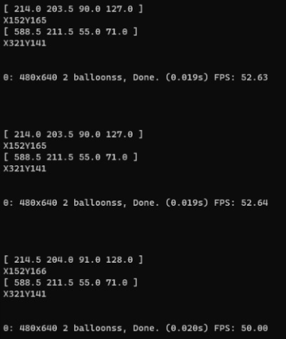
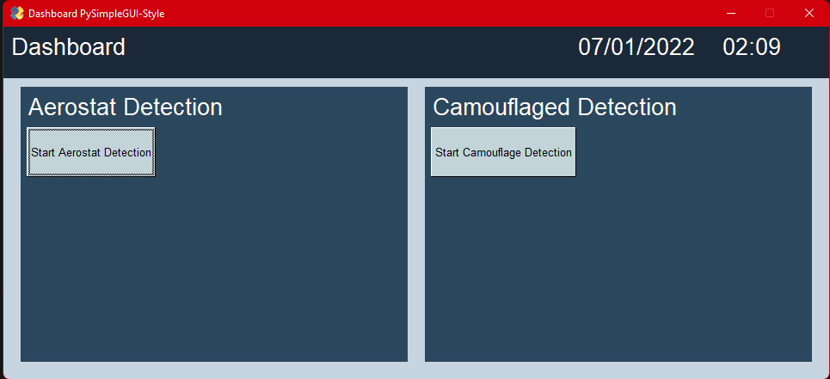
GUI
Class
Probability
X Y W H
(X,Y) Center of Mass

Slide 19
Thank You For Listening !

